Slide 1
How To Get Your Stories In Front Of The Readers Who Need Them
Will Estes

Slide 2

Most advice on making a living as a writer tells you to hustle, place ads with the right keywords and the like. That absolutely works. It’s also not why you’re an author.
You want to know your story reached the one reader who needed it. And if there’s one reader who needs your stories, there’s more than one.

Slide 3

Step 1: Find a review by a reader who deeply connected with your story.
You’re looking for reviews that go beyond “great book!” — the ones where a reader took time to describe what the story did to them. They might be on book-focused sites, blogs, or social media posts. These are the readers who got it. They’re the seed of everything that follows.

Slide 4

Step 2: Comment on their review with heartfelt thanks.
Thank the reviewer for their review. Ideally you do this on the review itself. Be as specific as they were. Be as warm as they were. You’re not just thanking one reader. You’re showing every future reader what it looks like when someone gets your work and you notice.

Slide 5

Step 3: Share what they connected with in your story.
Share what the reader actually connected with in your story publicly to your audience: on social media, your email list, wherever your readers are. Before you thanked them. Now you’re responding to the specific thing they connected with. You’re not just responding to one person. You’re becoming a beacon: showing other readers like them that your stories are out there and that someone who needed your stories already found them.

Slide 6
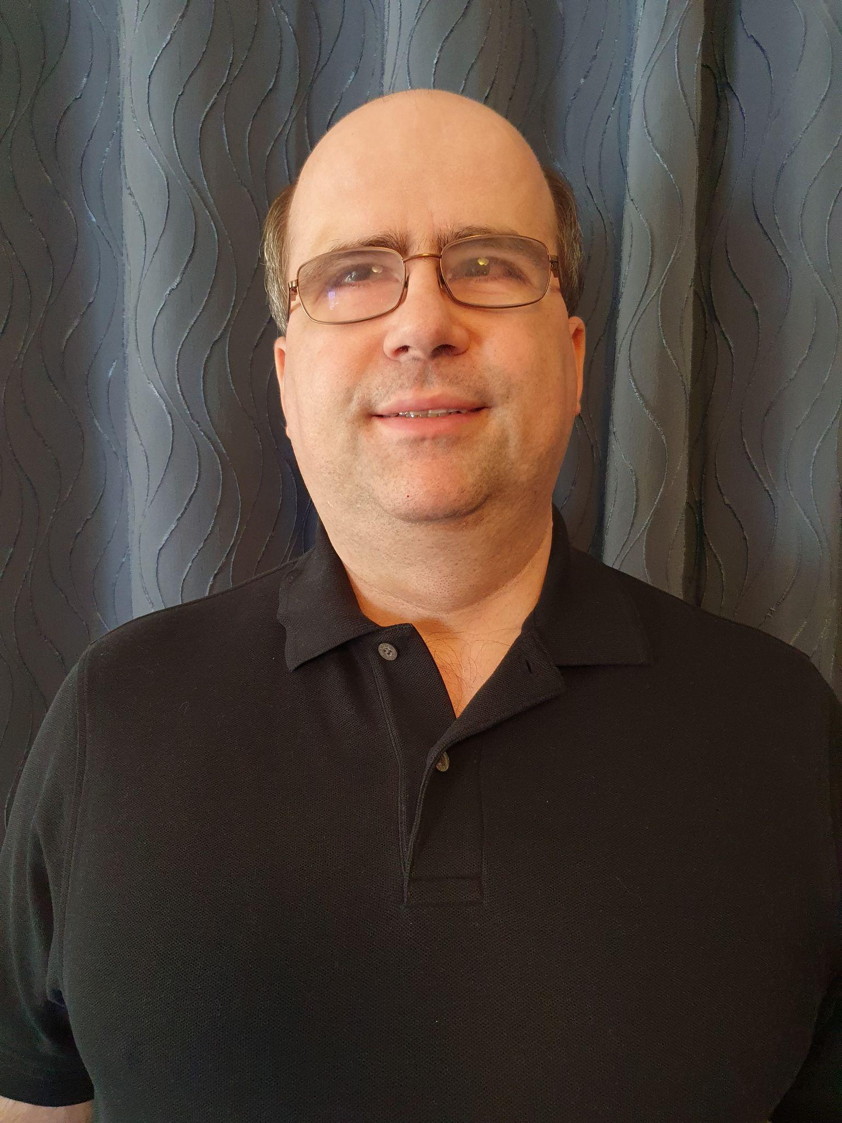
By: Will Estes — ReGround
Are you wondering how to get your stories in front of readers who need them?
Let’s talk one on one and find out if working with me is the right fit for you. I’ll look at your specific situation. We’ll map out how you get your stories to reach the readers who need them.
Get a Free Strategy Session

